Slide 1
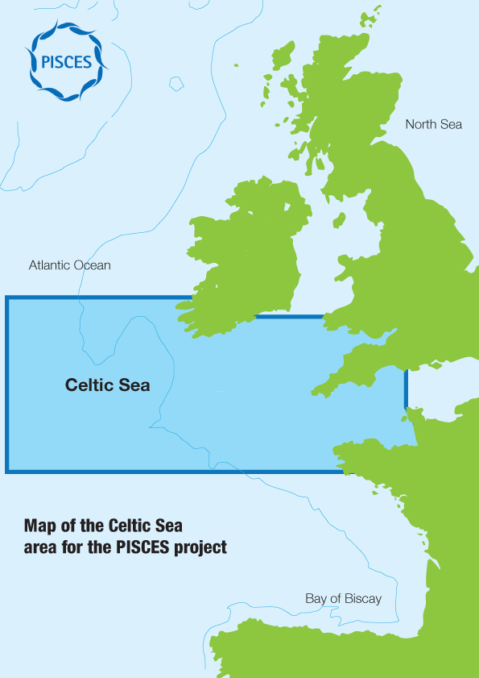
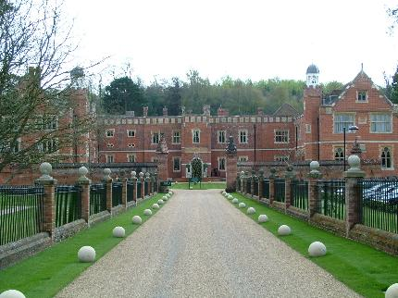
Welcome to Dorking
PISCES Workshop 4

Slide 2
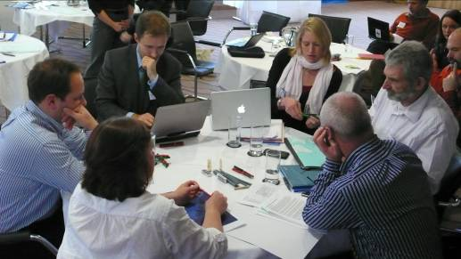
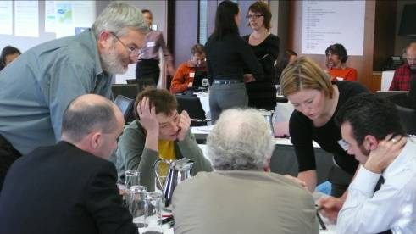
Introductions

Slide 3
Meeting Roles
PISCES core participants
Other participants
PISCES support team

Slide 4
Objectives
1. Review and give feedback on the latest draft of the guidelines
2. Share and gain insights on voluntary measures in the Celtic Sea and consider the opportunities for their wider application and implementation.
3. Identify networks and relevant contacts who would undertake a review of the guidelines.
4. Confirm the guidelines structure and way forward for the guidelines development process.

Slide 5
Agenda
Morning 1 0900 Introduction and Orientation /
Sharing Voluntary Measures
Lunch 1300
Afternoon 1 1400 Voluntary Measures continued /
Review Tasks
Dinner 1930
Morning 2 0900 Review Guideline Steps: “What more?”
Lunch 1300
Afternoon 2 1400 Review Guideline Steps continued /
Way Forward
Dinner 1930

Slide 6
Logistics
Safety
Working methods
Break-out rooms
Breaks
Facilities & refreshments

Slide 7
Code of Practice
Respecting everyone – avoid speaking over anyone
Being fully present – keep phone and email outside of the meeting rooms
Feeding back – let the PISCES team know immediately if you have any concerns or questions

Slide 8
PISCES: The story so far

Slide 9
We aim to:
Influence Marine Strategy Framework Directive (MSFD) implementation
Create an opportunity for stakeholders to demonstrate acceptable guidelines
Develop strength in a common voice

Slide 10
The PISCES approach
To develop a common understanding of the Ecosystem Approach with marine users.
To produce a set of stakeholder-led guidelines for implementing the Ecosystem Approach
To establish the best methods for engaging with diverse groups of marine users.

Slide 11
A unique project
Multinational, multi-sector
Stakeholder-led
Innovative stakeholder engagement
Increases knowledge, builds trust
A voice for Celtic Sea marine users
Acts as an example of best practice

Slide 12
Celtic Sea sub-region
Where are we working?

Slide 13


PISCES timeline
OCT: Online tutorials
JUN: Third stakeholder workshop
APR: Fifth stakeholder workshop
JUL: Guidelines finalised
DEC: new end date
MAY: First stakeholder workshop
NOV: Second stakeholder workshop
SUMMER: Consultation / review with sectors
NOV: Fourth stakeholder workshop
OCT: Guidelines launched to government and industry

Slide 14
Progress to date

Slide 15
Workshops
Workshop 1 (Cardiff)
  Multi-sector, multi-national group
  Ecosystem Approach (EA) definitions
Workshop 2 (Cork)
  PISCES principles
  Stakeholder engagement
Workshop 3 (Dinard)
  Principles, objectives, actions (mind maps)

Slide 16
Interim development
Drafting with volunteers
Developing structure
Involving advisors
Incorporating comments
Stakeholder survey

Slide 17
Workshop IV
1. Review and give feedback on the latest draft of the guidelines
2. Share and gain insights on voluntary measures in the Celtic Sea and consider the opportunities for their wider application and implementation.
3. Identify networks and relevant contacts who would undertake a review of the guidelines.
4. Confirm the guidelines structure and way forward for the guidelines development process.

Slide 18


Guidelines structure
Workshop day 2
Workshop day 1

Slide 19
Looking ahead
Refining drafts – stakeholders, advisors, team
Involving wider stakeholders
Additional information through surveys
Workshop April 2012
Launch October 2012

Slide 20
Looking ahead
Workshop V – April 2012
  Role of stakeholders in delivering EA
  Recommendations
  Life after PISCES

Slide 21
Questions?

Slide 22
Guidelines structure
Workshop day 1

Slide 23
Introducing Measures
Measures are actions, initiatives and activities for the delivery of sustainable marine management
Wide range of measures needed to implement sustainable management
Can be voluntary or statutory (MSFD)
Government requirement and stakeholder opportunity

Slide 24
Types of Measures

Slide 25
Any other Voluntary Measures?
Changes in location / intensity / type of activity
Process / technical changes etc
Mitigation and remediation
Voluntary agreements / codes of conduct
Developing environmental plans / strategies
Stakeholder engagement / contributing to stakeholder fora
Data sharing / joint fact finding

Slide 26
Voluntary Measures
  What could you replicate?
  What could you do with other sectors?

Slide 27
Voluntary Measures
What next?
  What should happen with output?
  Who should be involved?
  Volunteers to help?

Slide 28
Dinner 7.30

Slide 29
Guidelines

Slide 30
Welcome back

Slide 31
Guidelines structure
Section
1) Introduction | Background, objectives and target audience for the guidelines, and instructions on use
2) Implementation of the ecosystem approach in the Celtic Sea | Exploration of what needs to be done at each step in the policy implementation process in order to implement the ecosystem approach
3) Sectoral measures in the Celtic Sea | Exploration of voluntary measures are and could be implemented in the Celtic Sea by industry sectors, and links with the statutory MSFD of measures
4) Summary of recommendations | Recommendations grouped by target audience / organisation
5) Applying the guidelines in other locations | Recommendations on how the guidelines can be applied elsewhere in other contexts
6) Appendices | Map, background info, acronyms etc
Workshop day 2
Workshop day 1

Slide 32
Introduction
Presentation aims:
Recap draft guidelines structure
Rationale for structure
Highlight how stakeholder input (incl workshop exercises) feed into guidelines
Questions

Slide 33
Guidelines structure
What should the guidelines look like?

Slide 34
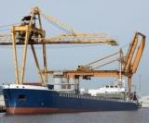
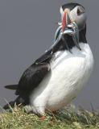
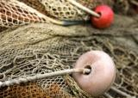




Guidelines structure:
some considerations
PISCES objectives
Target audiences (sea-users / policy makers)
Progress at workshops 1-3
Policy context and drivers for ecosystem approach (MSFD, MSP, CFP, MPAs)
Key issues / Celtic Sea context
Other existing guidelines (e.g. CBD, UNEP, ICES)
Other projects (KnowSeas, CAMIS etc)
Balance (simplicity vs information)

Slide 35
Guidelines structure
Section | Scope / purpose
1) Introduction | Background, objectives and target audience for the guidelines, and instructions on use
2) Implementation of the ecosystem approach in the Celtic Sea | Exploration of what needs to be done at each step in the policy implementation process in order to implement the ecosystem approach
3) Sectoral measures in the Celtic Sea | Exploration of what voluntary measures are and could be implemented in the Celtic Sea by industry sectors, and links with the statutory MSFD programme of measures
4) Summary of recommendations | Recommendations grouped by target audience / organisation
5) Applying the guidelines in other locations | Recommendations on how the guidelines can be applied elsewhere in other contexts
6) Appendices | Map, background info, acronyms etc

Slide 36
Guidelines structure
Section
1) Introduction | Background, objectives and target audience for the guidelines, and instructions on use
2) Implementation of the ecosystem approach in the Celtic Sea | Exploration of what needs to be done at each step in the policy implementation process in order to implement the ecosystem approach
3) Sectoral measures in the Celtic Sea | Exploration of voluntary measures are and could be implemented in the Celtic Sea by industry sectors, and links with the statutory MSFD of measures
4) Summary of recommendations | Recommendations grouped by target audience / organisation
5) Applying the guidelines in other locations | Recommendations on how the guidelines can be applied elsewhere in other contexts
6) Appendices | Map, background info, acronyms etc
Workshop day 2

Slide 37
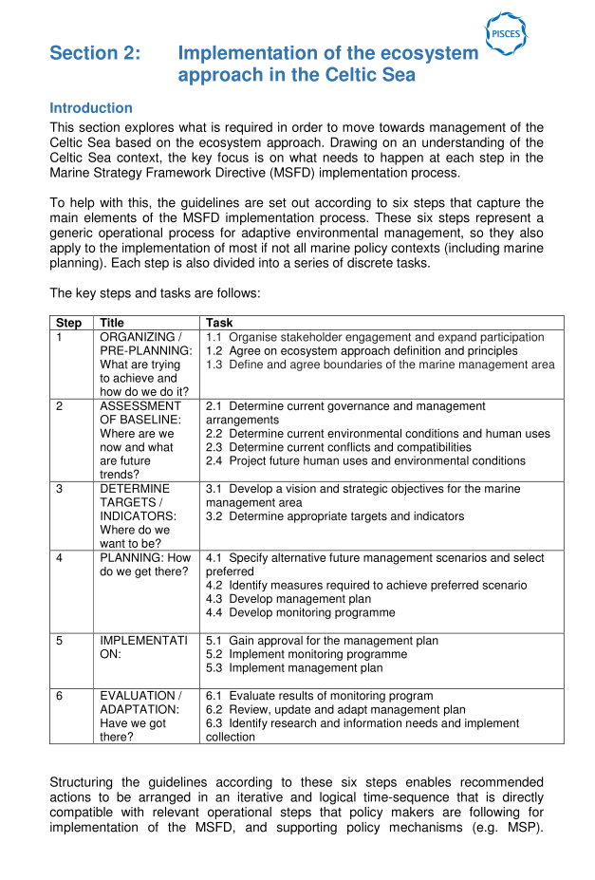
Guidelines: Section 2

Slide 38
Guidelines: Section 2
Structure / format:
  Step-by-step process (6 steps, 19 tasks)
  Aligns with policy implementation process (MSFD)
  Cyclical (adaptive management)
Advantages:
  Iterative and logical time-sequence
  Clear links to specific MSFD actions

Slide 39
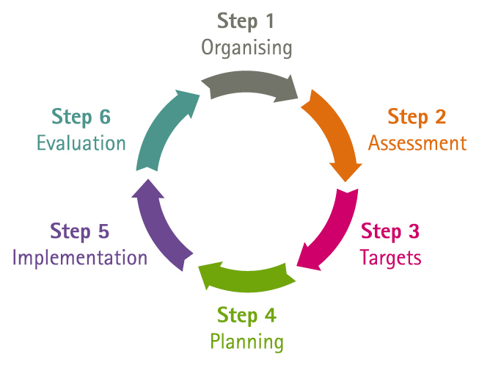
Guidelines: Section 2

Slide 40
MSFD and PISCES
2010
2011
2012
2013
2014
2015
2016
2017
2018
2019
2020
Spatial protection measures identified
Establish and implement monitoring programme
MSFD enters member state legislation
Determine what GES means
Programmes of measures for GES
Programmes of measures operational
Achieve or maintain GES
Targets and indicators for each region

Slide 41
Guidelines: Section 2
Step | Title | Task
1 | ORGANISING | 1.1 Organise stakeholder engagement and expand participation 1.2 Agree on ecosystem approach definition and principles 1.3 Define and agree boundaries of the marine management area
2 | ASSESSMENT OF BASELINE | 2.1 Determine current governance and management arrangements 2.2 Determine current environmental conditions and human uses 2.3 Determine current conflicts and compatibilities 2.4 Project future human uses and environmental conditions
3 | TARGETS / INDICATORS | 3.1 Develop vision and strategic objectives for marine management area 3.2 Determine appropriate targets and indicators
4 | PLANNING | 4.1 Specify alternative future management scenarios and select preferred 4.2 Identify measures required to achieve preferred scenario 4.3 Develop management plan 4.4 Develop monitoring programme
5 | IMPLEMENTATION | 5.1 Gain approval for the management plan 5.2 Implement monitoring programme 5.3 Implement management plan
6 | EVALUATION / ADAPTATION | 6.1 Evaluate results of monitoring program 6.2 Review, update and adapt management plan 6.3 Identify research and information needs and implement collection

Slide 42
Guidelines: Section 2
Structure provides means to:
Integrate stakeholder work to date (e.g. mindmaps)
Explore overarching requirements for EA (e.g. policy, governance, management, data, participation etc)
Highlight who needs to do what, and how stakeholders can participate in each task
Links to ecosystem principles (PISCES interpretation)

Slide 43
Are we going in the right direction?

Slide 44
Guidelines Structure
& Rationale
How user-friendly is the current document
For your sector?
For policy/decision makers?
  What do you like most?
  What do you think needs to be changed?
  Is anything missing?

Slide 45
Guidelines Document
How satisfied do you feel about the balance between stakeholder/advisor/team input so far?
To what extent do you feel that stakeholders “own” these guidelines?

Slide 46
Guidelines: Section 2

Slide 47
Guidelines: Section 2

Slide 48
Guidelines: Section 2
Step | Title | Task
1 | ORGANIZING | 1.1 Organise stakeholder engagement and expand participation 1.2 Agree on ecosystem approach definition and principles 1.3 Define and agree boundaries of the marine management area
2 | ASSESSMENT OF BASELINE | 2.1 Determine current governance and management arrangements 2.2 Determine current environmental conditions and human uses 2.3 Determine current conflicts and compatibilities 2.4 Project future human uses and environmental conditions
3 | TARGETS / INDICATORS | 3.1 Develop vision and strategic objectives for marine management area 3.2 Determine appropriate targets and indicators
4 | PLANNING | 4.1 Specify alternative future management scenarios and select preferred 4.2 Identify measures required to achieve preferred scenario 4.3 Develop management plan 4.4 Develop monitoring programme
5 | IMPLEMENT-ATION | 5.1 Gain approval for the management plan 5.2 Implement monitoring programme 5.3 Implement management plan
6 | EVALUATION / ADAPTATION | 6.1 Evaluate results of monitoring program 6.2 Review, update and adapt management plan 6.3 Identify research and information needs and implement collection

Slide 49
Guidelines: Section 2
Section | Status / drafting approach
a) How task should be implemented in line with ecosystem approach (generic / ideal scenario) | Rough draft by team / advisors, reviewed by some stakeholders
b) Application of the task in the Celtic Sea (progress, issues/considerations) | Rough draft by team / advisors, not yet looked at in detail by stakeholders
c) What more needs to be done (given b) | Not yet drafted – key focus for workshop 4
d) Stakeholder participation (who needs to be involved, how and why) | Not yet drafted – key focus for workshop 5

Slide 50
Guidelines: Section 2
Section | Status / drafting approach
a) How task should be implemented in line with ecosystem approach (generic / ideal scenario) | Rough draft by team / advisors, reviewed by some stakeholders
b) Application of the task in the Celtic Sea (progress, issues/considerations) | Rough draft by team / advisors, not yet looked at in detail by stakeholders
c) What more needs to be done (given b) | Not yet drafted – key focus for workshop 4
d) Stakeholder participation (who needs to be involved, how and why) | Not yet drafted – key focus for workshop 5

Slide 51
Guidelines: Section 2
For each task – what are:
Key issues/considerations that are important in implementing the task in the Celtic Sea?
The potential implications and impacts of these issues / considerations?
Solutions and/or further requirements for each issue/consideration, and who will deliver these?
Further information required to identify solutions?

Slide 52
What more needs to be done?
3 table groups: Steps 1 to 3
Go with your interest
Take 5 minutes to read through each Task before answering the questions
Don’t worry if you can’t answer: note clearly why not

Slide 53
OSPAR’s View of Regional Implementation:
David Johnston, OSPAR

Slide 54
What more needs to be done?
3 table groups: Steps 4 to 6
Go with your interest
Take 5 minutes to read through each Task before answering the questions
Don’t worry if you can’t answer: note clearly why not

Slide 55
Considerations
Need for wider review from sectors
  Who and when?
  How many times?
Role of team/Advisory Group/core group
How much time do people have to input?
How to involve under-represented sectors

Slide 56
Next steps

Slide 57
Proposed approach
Workshop summary – December 2011
Next draft for review – January 2012
  Comments within 4 weeks (Core group & AG)
  Circulate within sector and collate comments
Possible surveys – February 2012
Review comments/draft – March 2012
Workshop 5 – April 2012

Slide 58
Proposed approach
Review post workshop draft – May 2012
  Comments within 4 weeks (Core group & AG)
  Circulate within sector and collate comments
Review comments – July 2012
Finalise draft – August 2012
Launch – October 2012

Slide 59
Feedback

Slide 60
Thank you

